Slide 1
Do rates of covid19 differ based on local policies implemented?

Slide 2

Background

Slide 3
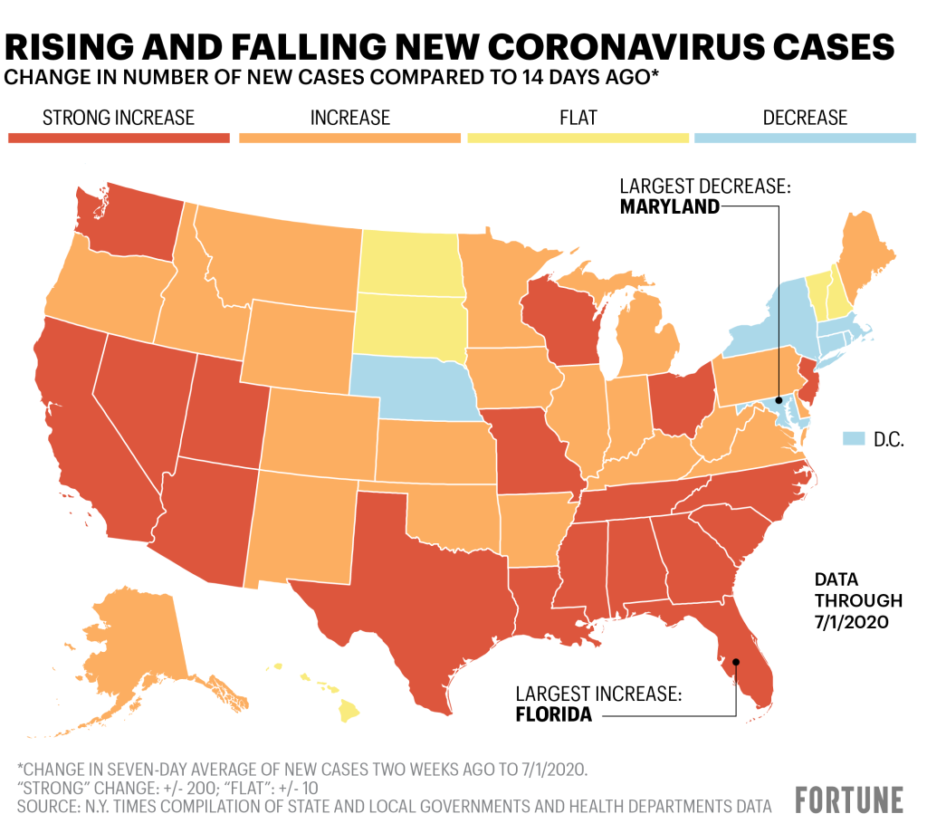

Slide 4
Resources
John Hopkins University Covid19 data
NY Times
CA and TX Health Government websites (policy implementation)

Slide 5
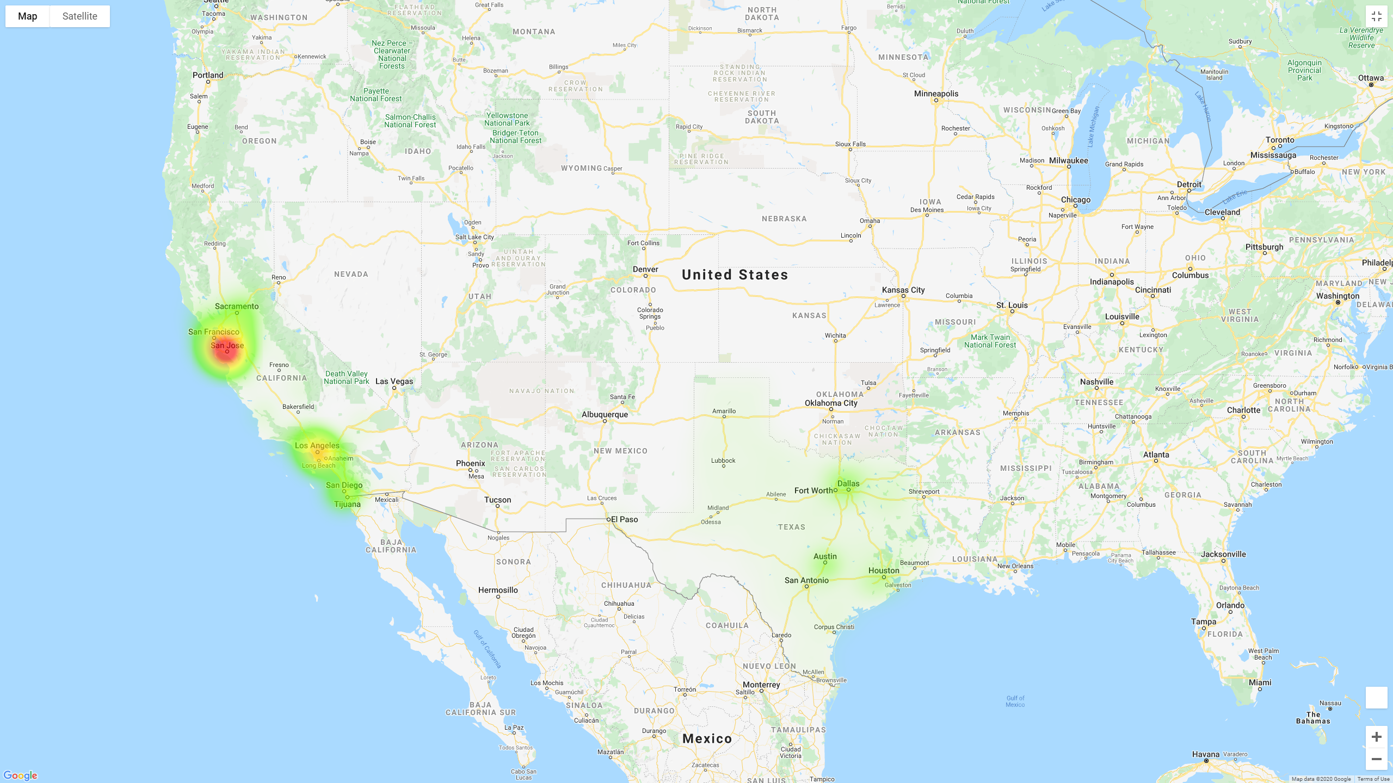

Slide 6
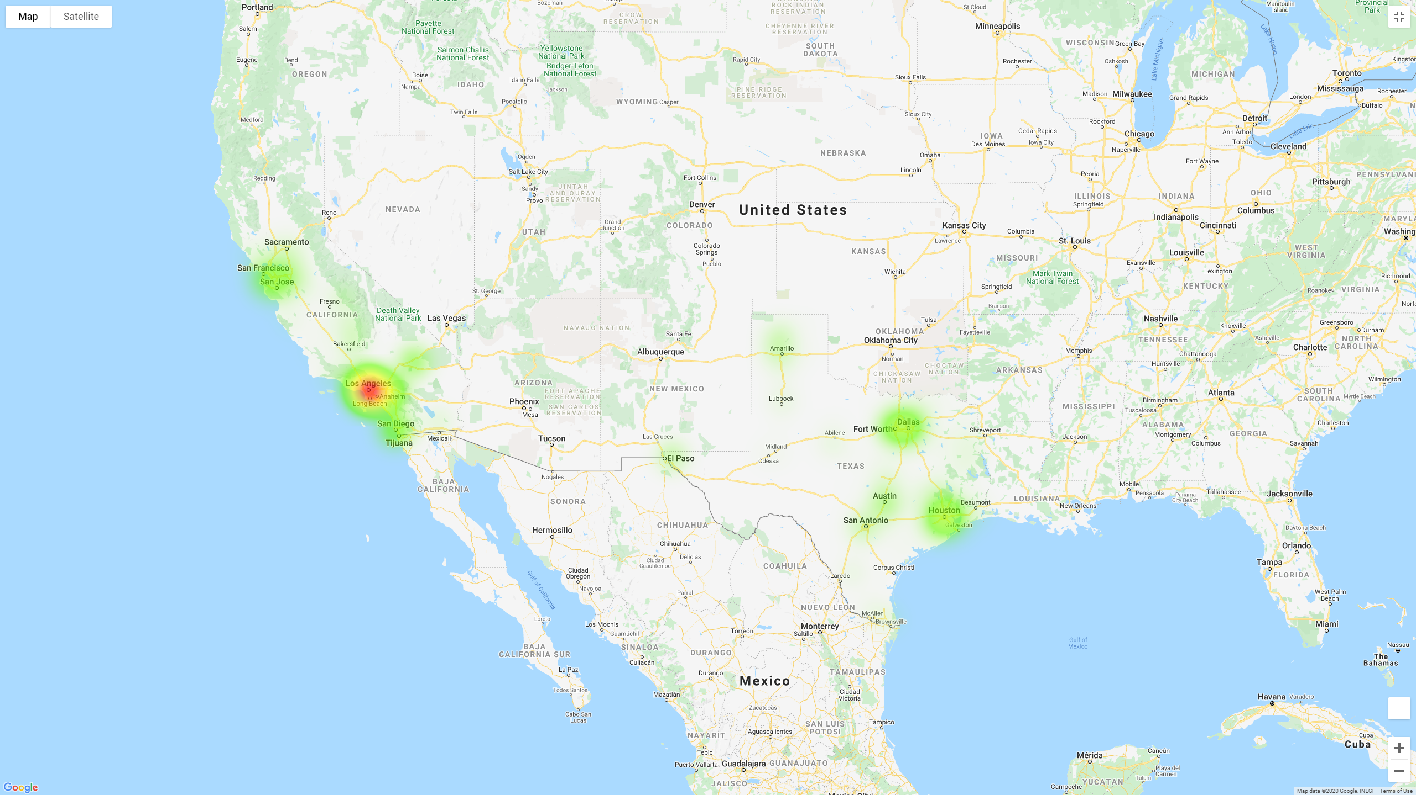

Slide 7
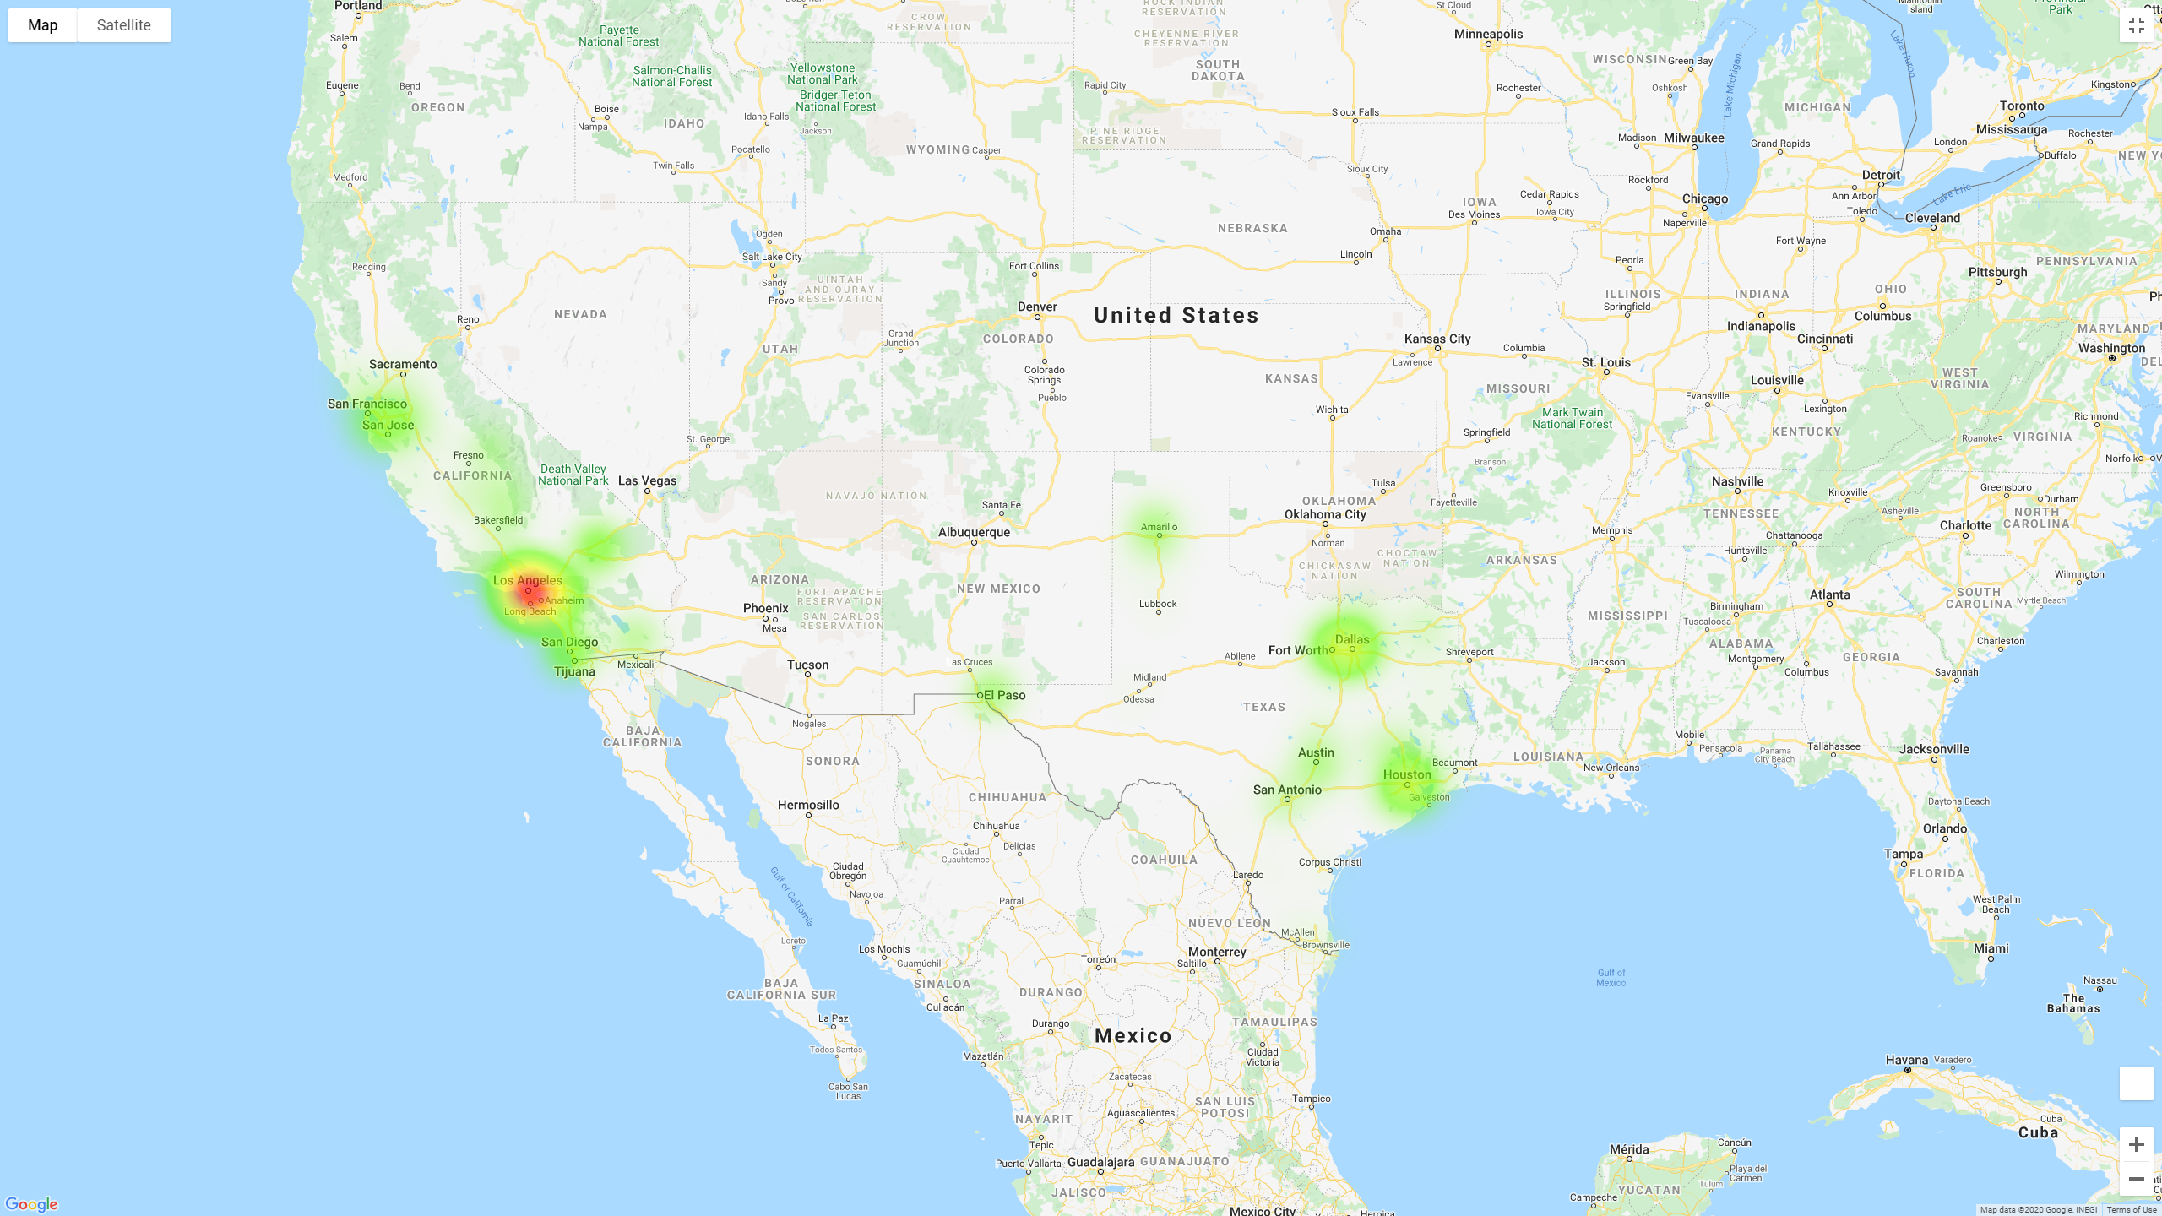

Slide 8
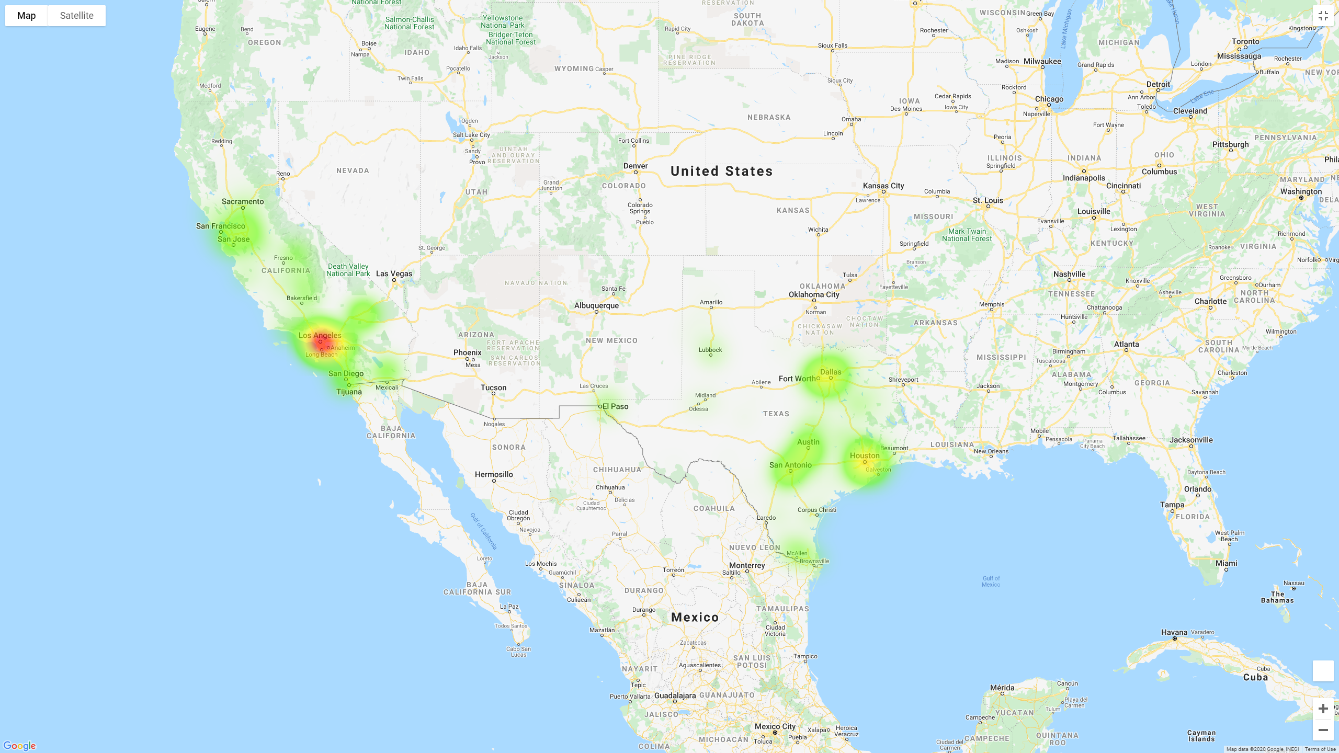

Slide 9
